Slide 1

LumiFlex
Smart LED Panel
Innovating the Future – Bringing Ideas to Life
Presented By:
Group 08

Slide 2

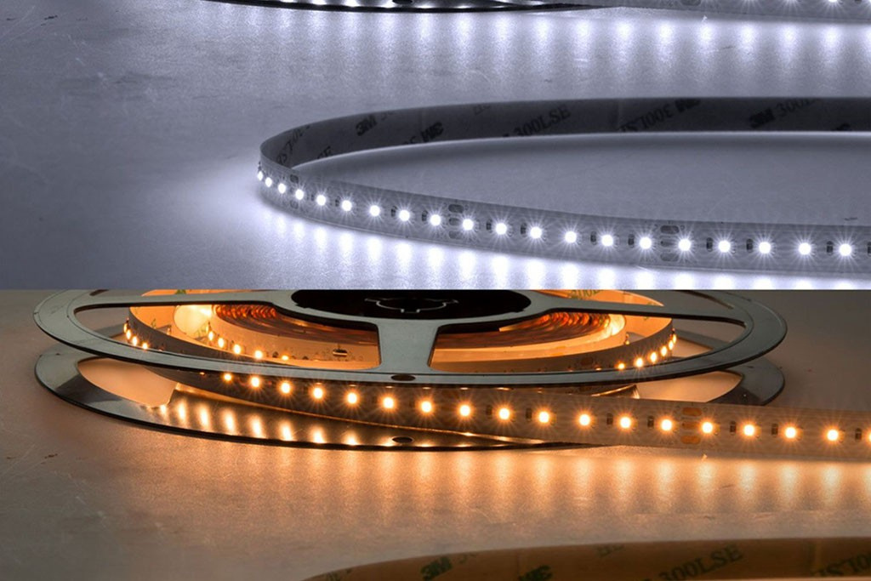
Key Features
Adjustable Brightness
Utilizes smooth, flicker-free PWM (Pulse Width Modulation) dimming to provide customizable light intensity while maintaining eye comfort and stability.
Adjustable Color-Temperature
The system features two LED channels (warm and cool white), allowing users to adjust the color temperature in stepless adjustments to suit different environments or moods
Microcontroller Integration
It uses an ESP32 MCU to receive commands from the app and generate the necessary PWM signals for lighting control.
Smart App Control
The LED Panel light is controlled wirelessly via a mobile application using Wi-Fi
Page 01

Slide 3
Product Specifications
Total Cost = LKR Rs. 4461
Price LKR Rs. 5000
Page 02

Slide 4
Product Development Lifecycle
Phase 1
Block Diagram
Phase 2
Circuit Design
Defined the system architecture to map out connections between the microcontroller, power supply, and LED drivers
Created and simulated detailed electronic schematics to ensure proper voltage regulation and signal integrity for the LED control.
  Platforms: Proteus
Phase 3
PCB Design
Phase 4
Code Implementation
Designed the physical board layout, routing tracks and defining component footprints to prepare the circuit for manufacturing.
  Platforms: KiCad
Developed the firmware for the microcontroller and the mobile app interface (Dart/Flutter) to enable WiFi-based brightness and color control.
  Platforms : Arduino cloud, VS-Code
Phase 5
Assemble
Phase 6
Troubleshooting
Soldered electronic components onto the printed circuit board and integrated the hardware into the LED panel enclosure.
Tested the complete system to resolve connectivity bugs and refine the app responsiveness using real-time debugging tools.
  Platforms: Visual Studio, Arduino Cloud
Page 03

Slide 5
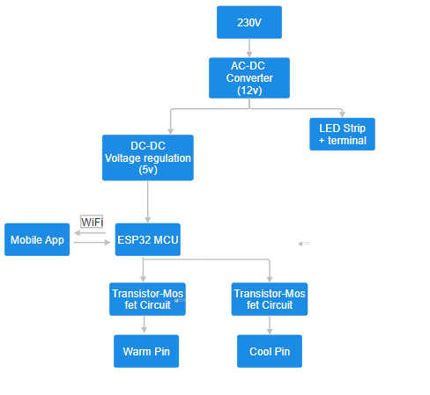
Block Diagram
Page 05

Slide 6
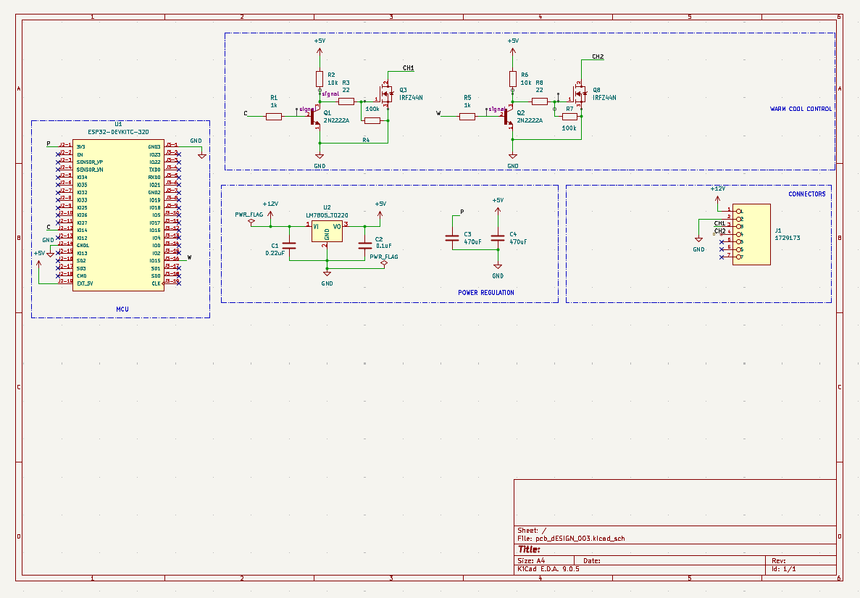
Circuit Design
Page 06

Slide 7
Circuit Design
Page 06

Slide 8
Circuit Design
Page 06

Slide 9
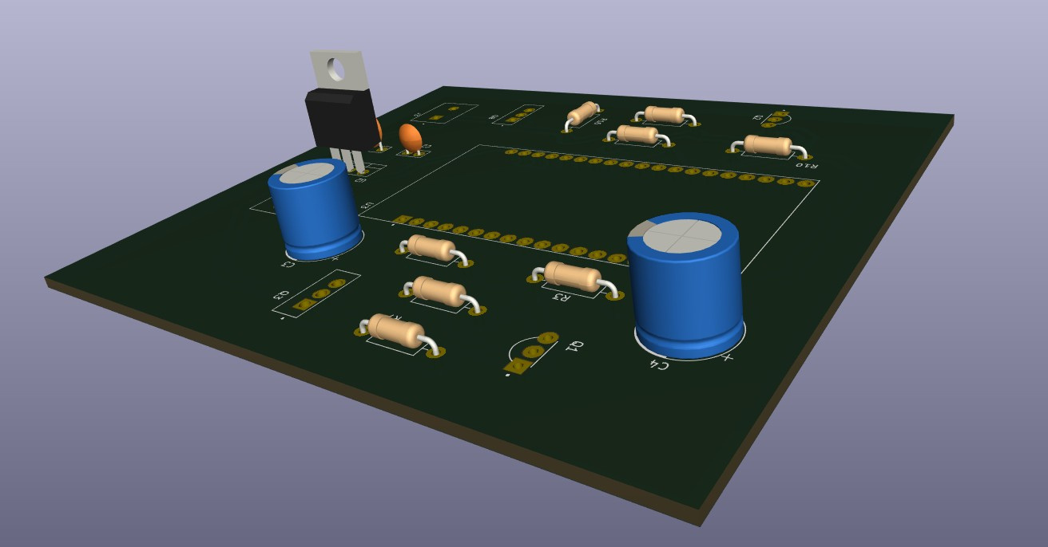
PCB Design
Page 06

Slide 10
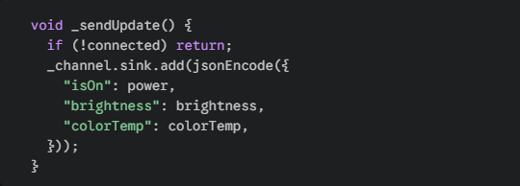
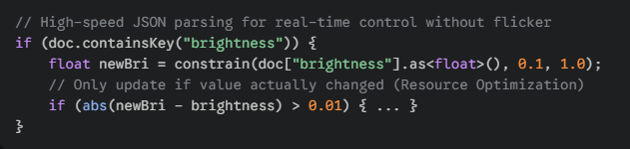
Code Implementation
Real Time Communication Logic
Challenge : Traditional HTTP requests require opening and closing a connection for every command. This introduces latency flicker when dimming.
Solution : WebSocket keeps a constant connection to the LED Panel light, sending all settings together in one JSON to ensure quick, smooth adjustments without flickering or delays.
Flutter Code in app control
C++ Code in controlling ESP32 board
Page 06

Slide 11
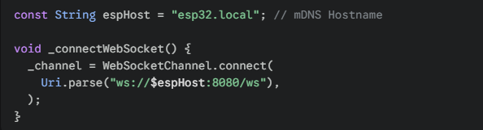
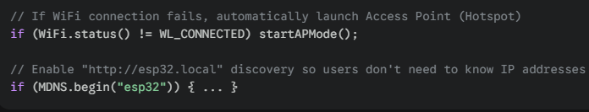
Code Implementation
Zero configuration User experience
Challenge : Users cannot be expected to find or type IPs to control their lights
Solution : Allowing the app to discover the ESP32 device by name automatically without requiring the user to know or enter IP addresses
Flutter Code in app control
(User Action)
C++ Code in controlling ESP32 board
(System Response)
Page 06

Slide 12
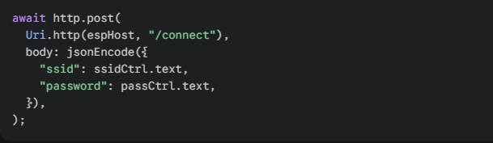
Code Implementation
Secure WiFi Provisioning
  App is used to securely transmit the network name and password to the device. Once it receives this information, the LED Panel connects to the network and operates independently
Page 06

Slide 13
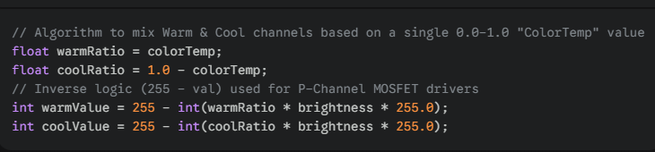
Code Implementation
Color mixing Algorithm
  Ratio Balancing: Dynamically adjusts channel ratios to ensure total brightness remains constant while shifting color temperature
Page 06

Slide 14
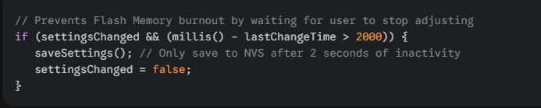
Code Implementation
Flash Memory Protection
  If a user slides the brightness bar rapidly in the app, the device doesn't write to memory 50 times a second (which would crash it or burn the chip). It waits until the user stops adjusting to save the final state
Page 06

Slide 15
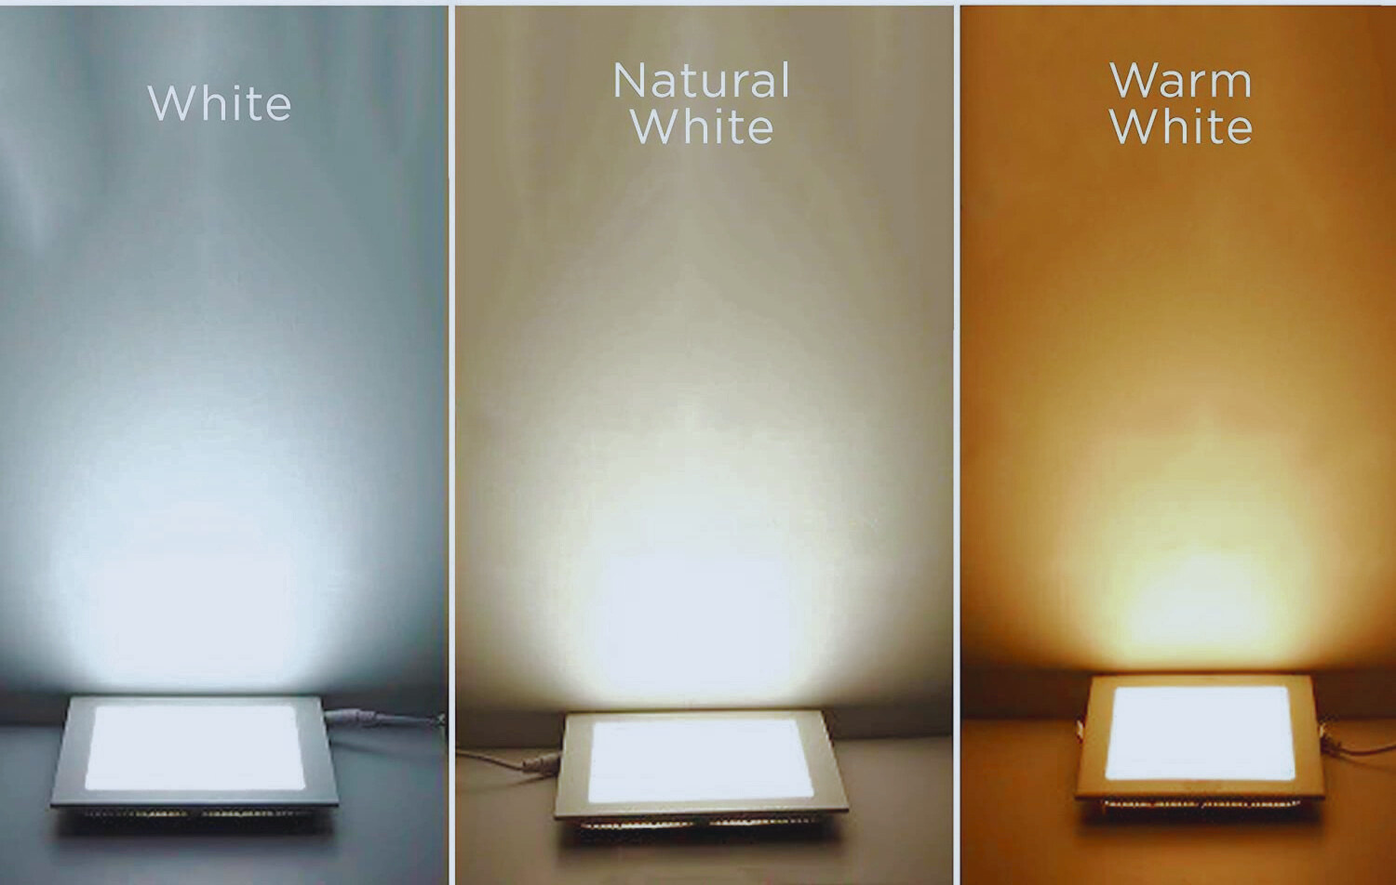
Future Improvements
Automatic Color Temperature Adjustment
The app could be programmed to automatically shift the color temperature throughout the day using cool blue light in the morning for alertness and warm amber light in the evening to reduce blue light exposure before sleep
Advanced Power Management
Implementing the ESP32’s Deep Sleep mode would significantly reduce power consumption when the lamp is not in use but still needs to stay connected to the network
Mesh Networking
If multiple Lumi-Flex units are used in a larger space, a Wi-Fi Mesh protocol could allow them to communicate with each other and act as a single synchronized system.
Page 04

Slide 16
Thank you
We appreciate your time and attention.

